Slide 1
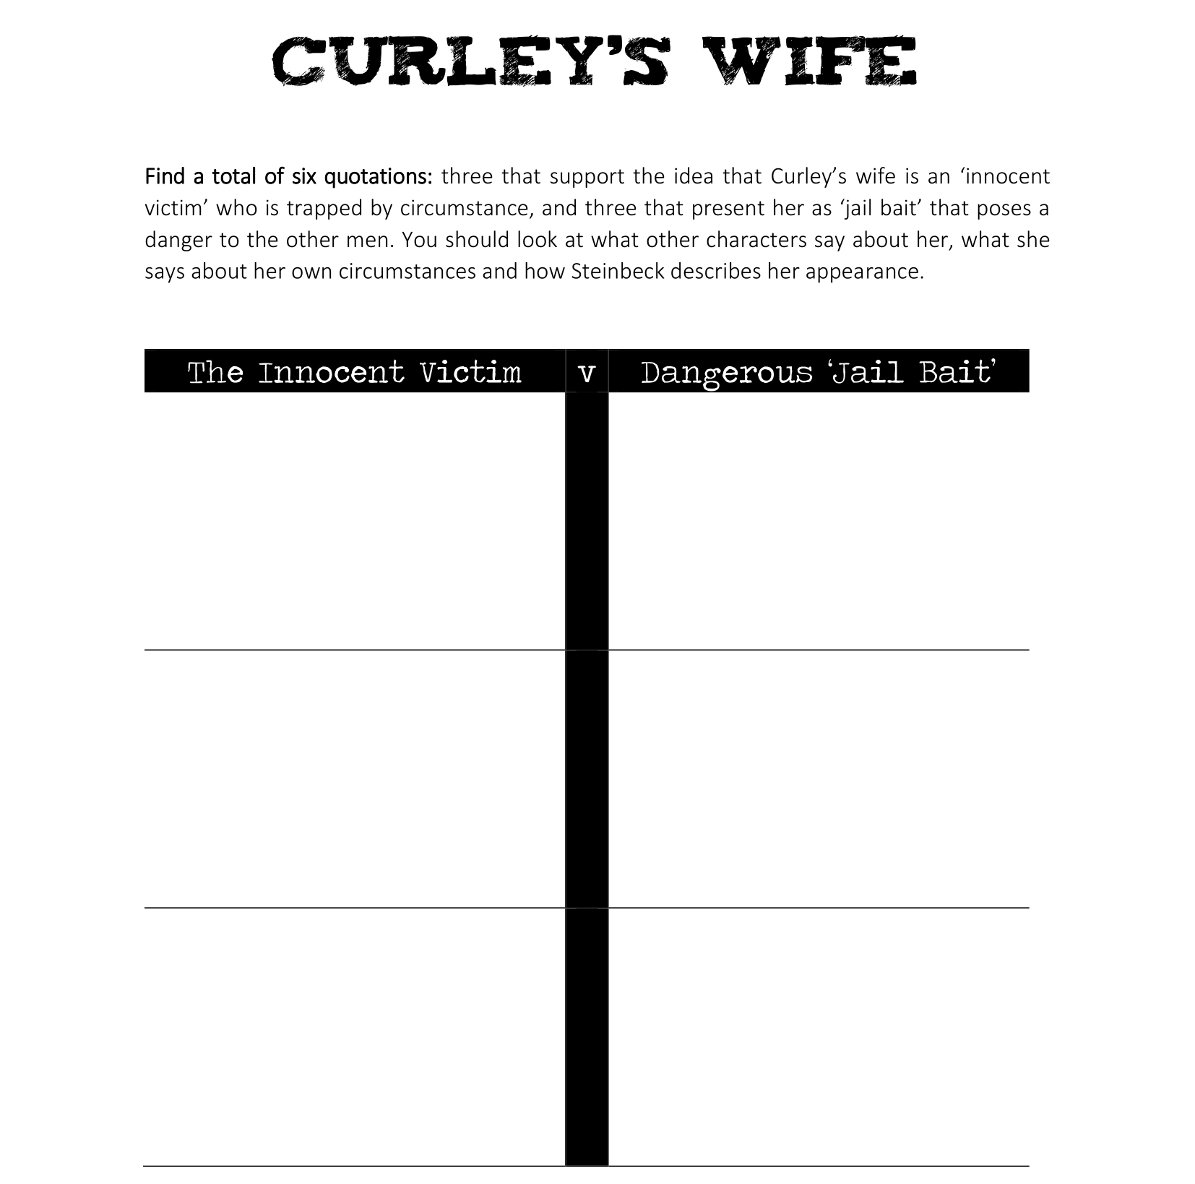
“___________” (Steinbeck __) | “___________” (Steinbeck __)
“___________” (Steinbeck __) | “___________” (Steinbeck __)
“___________” (Steinbeck __) | “___________” (Steinbeck __)

